Slide 1
Mobile Analytics Application Technical Overview
Backend
Architecture
Data Collection/Aggregation
Data Storage
Data Access
Systems
Frontend
Architecture
Screen Shots & Examples

Slide 2
Backend: Architecture
Data Collection/Aggregation:
Data scrapper tool written in J2EE 1.6
Java app, not service, but can be cron’ed to run when needed
Data source: REST webservices on http://itune.apple.com
Data destination: REST resources on http://dev.mobile-analytics-test.gotpantheon.com/
Tool features:
Data organized by brand, date, and platform
Data available in XLS in CVS, plain text, and from mySQL as records
Data available over:
User-defined date range
User-defined brand accounts in iTune

Slide 3
Backend: Architecture Continued
Data Storage:
Data storage via REST: http://dev.mobile-analytics-test.gotpantheon.com/
REST resources/endpoints: app, api
REST host: Drupal 7 viahttp:///www.getpantheon.com/
Storage: MySQL
Cache: Varnish

Slide 4
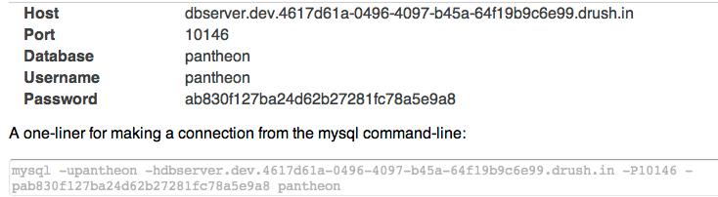
Backend: Architecture Continued
Data Access:
Direct access via MySql

Slide 5
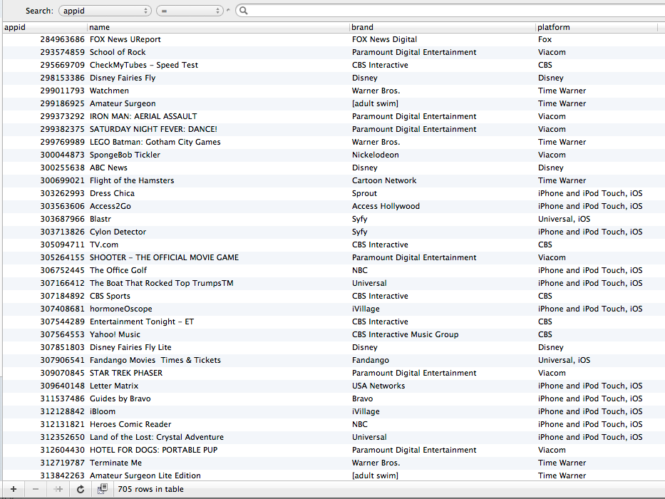
Backend: Architecture Continued
App Table (primary key: appid in iTune)

Slide 6
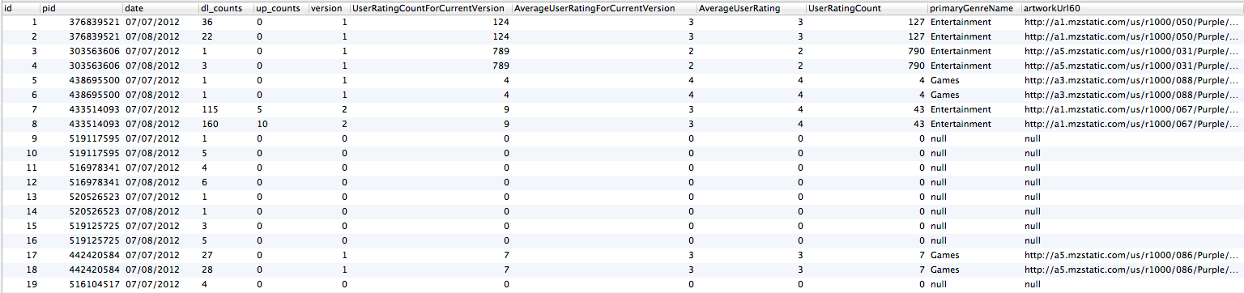
Backend: Architecture Continued
Appstats Table (foreign key: pid = appid)

Slide 7
Backend: Systems
Data Scrapper Tool
(J2EE 6.1)
User Web Browser
iTune Webservices
HTTP
REST calls
to endpoints
HTTP
Varnish
Cached data,
HTML markups, CSS, JavaScript, etc
Drupal 7
CMS
Webservice
MySql DB
HTTP CRUDs

Slide 8
Frontend: Architecture
CMS via Drupal 7
PaaS Hosting Service: http:///www.getpantheon.com/
Webservice available via Varnish cached http://dev.mobile-analytics-test.gotpantheon.com/
QA and production ready code can be deployed readily

Slide 9

Frontend: Architecture Continued
Codes are deployed on getpantheon PaaS site via the following time-based credential:
Language: PHP 5.1 on Drupal 7 / HTML / CSS / JavaScript

Slide 10
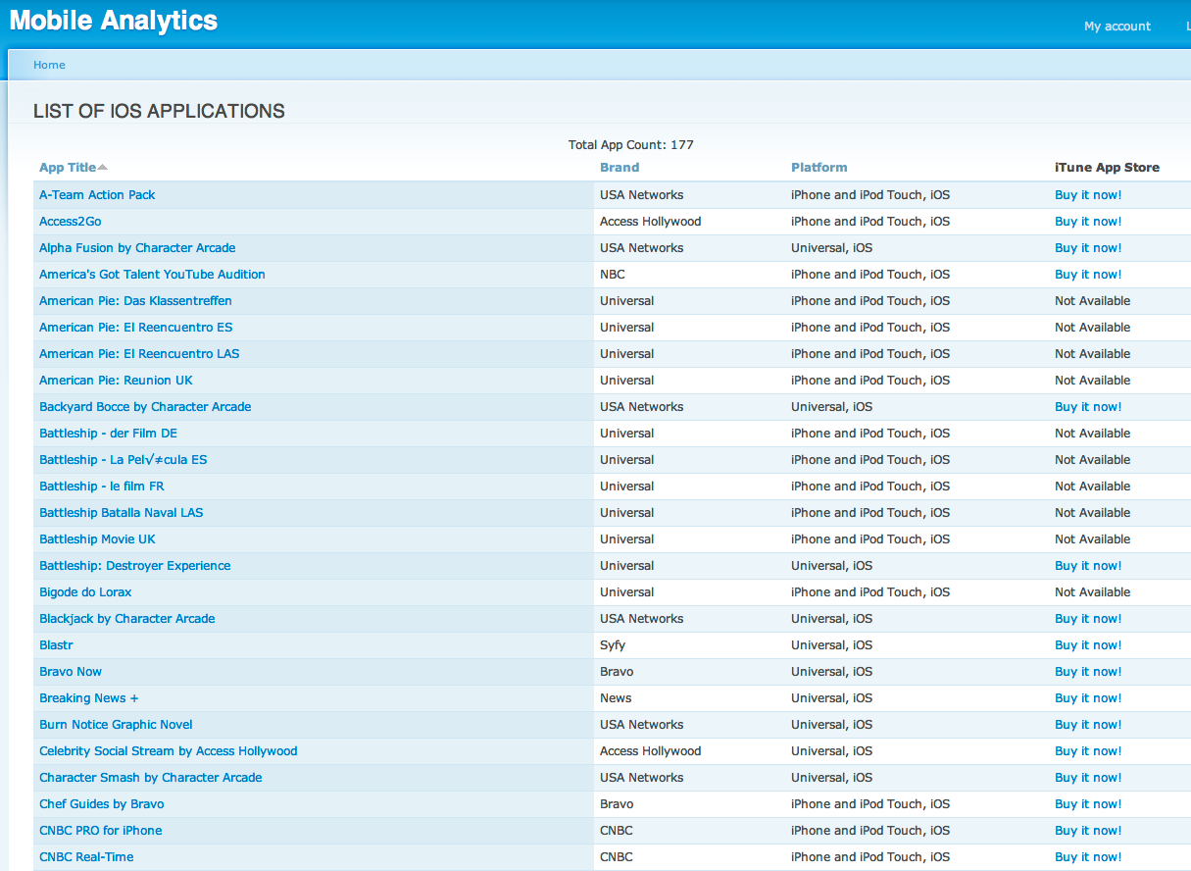
Screen Shots & Examples List of Sortable iOS Apps
http://dev.mobile-analytics-test.gotpantheon.com/appslist

Slide 11
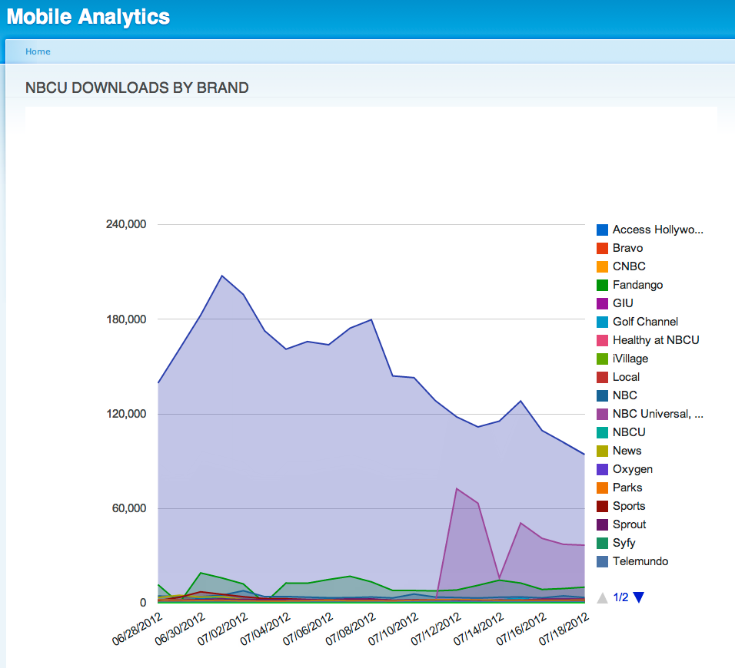
Screen Shots & Examples Live Downloads by Brand
http://dev.mobile-analytics-test.gotpantheon.com/dl_by_brands

Slide 12
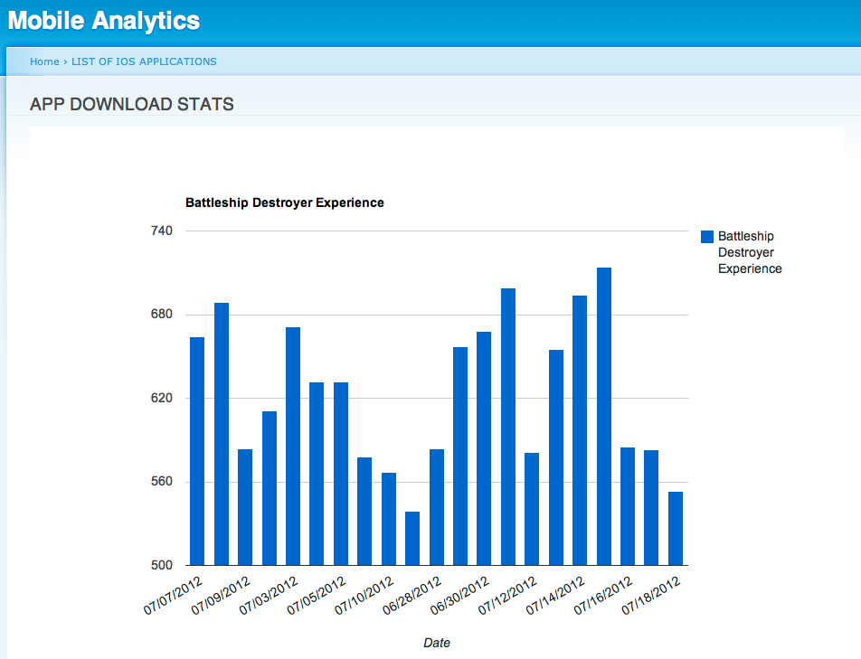
Screen Shots & Examples Live App Stats
http://dev.mobile-analytics-test.gotpantheon.com/appslist/graph/get/515365833

Slide 13
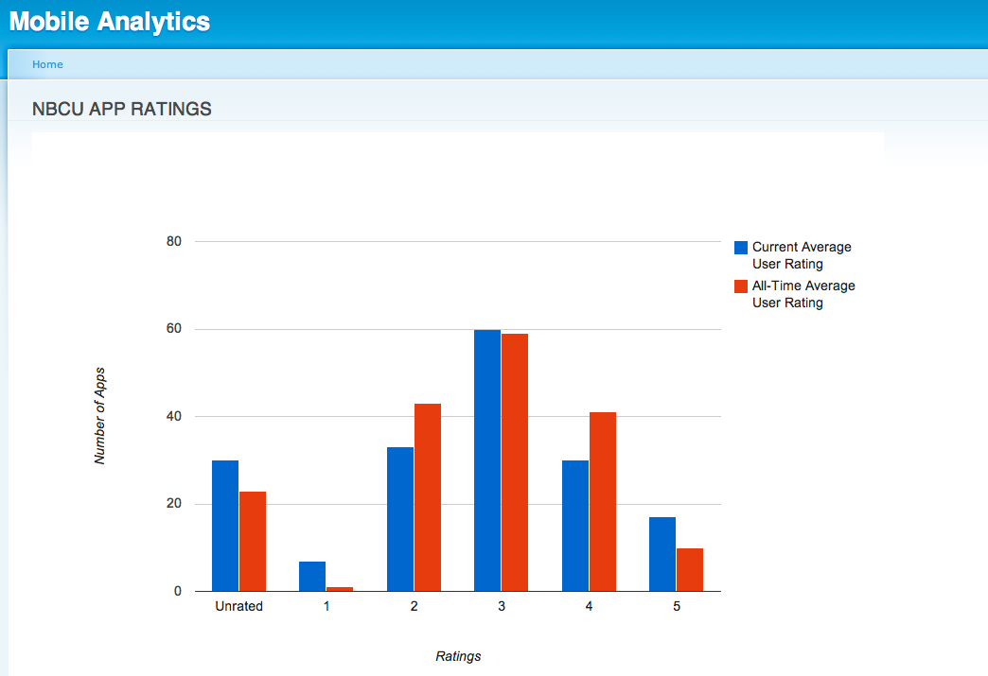
Screen Shots & Examples Live App Rating: NBCU
http://dev.mobile-analytics-test.gotpantheon.com/rating/nbcu

Slide 14
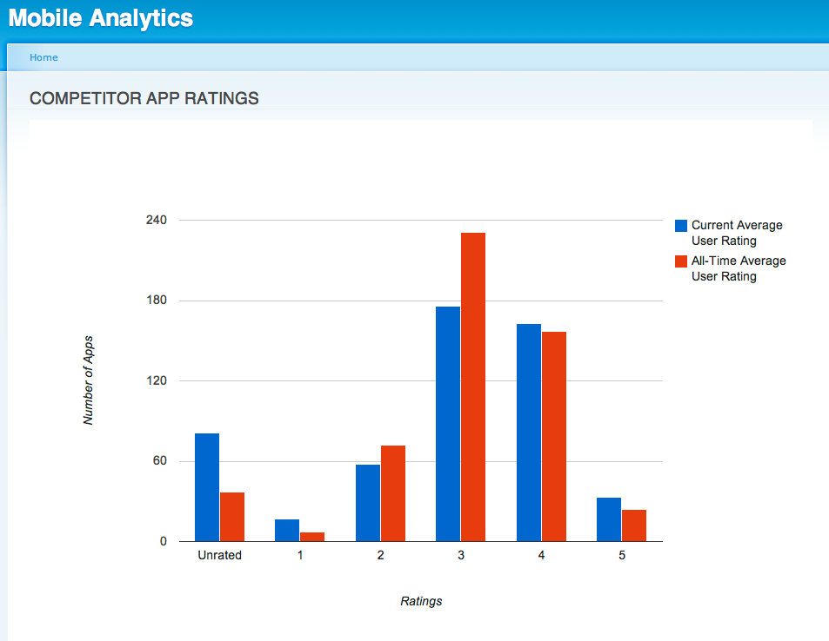
Screen Shots & Examples Live App Rating: Competitors
http://dev.mobile-analytics-test.gotpantheon.com/rating/competitors

